Slide 1
Bureau Of Statistics and Census
A PRESENTATION ON
Emerging Trends in Data Dissemination
Libya
2013

Slide 2
LEGAL BASIS
The National Statistics office, was established in 1963 and its amendments, until 2012 where a new provisional law replaced it under name of Bureau of statistics and census.

Slide 3
The current situation of Data Dissemination
Static Website data Dissemination (www.BSC.ly) .
Hard Copy (booklet ) .
USPs and laser printers (CDs).
On Demand by Programmers (PDF files ).
Facebook for (News) .
Local Tv Stations .

Slide 4
Strategic Plan For Dissemination Of Data
Build RDBMS for “User request data” .
Build DataWarehouse for (Historical data) .
BI (business intelligent) for Dynamic reports.
Libyan Statistics Portal (Dynamic Web basis).
Participation to build LibInfo (UN DevInfo) .
Interactive Online Dissemination database
Online Geo-Spatial database
Build RDBMS for “User request data” .
Analysis of data requests in regard to usersand reasons for not available data

Slide 5
Problems experienced
Lack of technical knowledge .
Variety of Databases .
Overlap in functions.
The absence of a clear mechanism for dissemination of data .
Data inaccessible .
Lack of knowledge of the value of data dissemination .

Slide 6
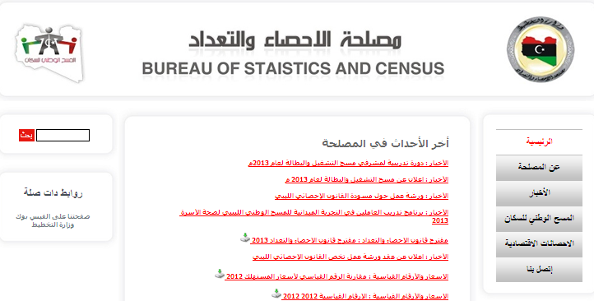
Website Data Dissemination www.bsc.ly

Slide 7
Thank You

